Slide 2
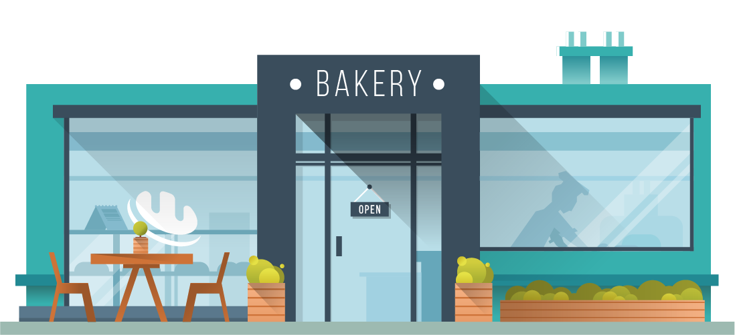
About the CC Bakery
Welcome
Here at the Creative Commons Bakery we take elements from your favorite license groups and recombine them in special ways to create unique ways for you to share your creative works.
Come inside an learn about some of our specialties…
2

Slide 3
House Specialty
3-Layer License
Here at the CC Bakery, one of our most popular creations is the 3-layer license. We start with a foundation of legal code. This provides the rich base upon which we build our creation. While most don’t think about this layer, it is the most essential part of the license. The second layer is the common deeds layer. This is the layer most recognized by our users, this provides all the flavor and meaning to the license. Finally the third layer; this is the sweetest layer. This is the layer that enables everyone to use our license. It is machine-readable and able to be shared across various platforms.
3

Slide 4
Ingredients
What goes into our licenses?
We have four primary ingredients that goes into all our licenses.
Attribution- this tells everyone who is the creator
Shareable- this allows you to share your creation with others and enables them to share what they create
Non-Commercial – when we use this ingredient, we ask that you not sell this to make a profit.
No Derivatives – Enjoy what we have created; unfortunately, you’re not able to recreate or alter our creation.
4

Slide 5
Let’s Make a License
Six License Options
Let’s look at the half-dozen options available for our creations:
1.) Attribution – Allows for the use of the creation as long as attribution is given to the creator
2.) Attribution-ShareAlike – Allows for the use of the creation as long as attribution is given, and you agree to share your creation under a similar license agreement.
3) Attribution-NonCommercial – Allows for use of the creation as long as attribution is given, and it is not sold for profit
4) Attribution-ShareAlike-NonCommerical – Allows for use of the creation as long as attribution is given, it’s shared as are its adaptations, and it’s for non-commercial purposes.
5) Attribution-NoDerivatives – You can only use the original creation as long as your credit the creator. You are not permitted to alter or adapt.
6) Attribution-NoDerivatives-NonCommerical- You can only use the original creation, you must credit the creator, and you can’t sell it to make a profit.
5

Slide 6
Decorations
Logos
When assigning a logo to your creation you can use a combination of these images to depict your license in a visual format. By using combinations of these logos you let a user know how they can use your creation.
6

Slide 7
Free Samples
Works that are in the Public Domain can be used freely without the worry of copyright. Public Domain is automatic for items published before 1924, however, creators can put current works directly into Public Domain. This is indicated by CC0.
7

Slide 8
How to place an order
Exceptions and Limitations
Remember that CC licenses do not reduce or limit any rights that are exceptions or limitations under copyright. This applies to fair use and fair dealing.
Public Domain
If an item is in the Public Domain, DO NOT apply a CC license. This also means that if you use an item in the public domain, you can’t apply a CC license to it with the intent of removing it from public domain.
8

Slide 9
Are You Hungry ? Have a Creation?
DON’T WAIT!
Get a CC License right now!
9

Slide 10
Citations
All photos were courtesy of Envato Elements
Cover photo: Bakery Scene Creator Top View by DesignSomething
Slide 2:Bakery - Vector Landscape & Building by aqrstudio
Slide 3:Triple chocolate layers baked cheese cake by kenishirotie
Slide 4:Ingredients for baking. Butter, eggs, sugar and flour by furmanphoto
Slide 5:Plain cupcakes on baking tray by Wavebreakmedia
Slide 6: Creative Commons logos https://creativecommons.org/about/downloads
Slide 7:Bowl with traditional Moroccan fekkas cookies by picturepartners
Slide 8:Mid section of waiter taking order by Wavebreakmedia
Slide 9:Chocolate cupcakes by NatashaBreen
Slide 10:Thank you cupcakes by RuthBlack

